Slide 1

MediSmart Futures: Sharp Health Predictions
Group of 4 members
Tran Thuy Van Phan
Mohamed Irfan Varvani
Manasa Uppalapati
Priya

Slide 2
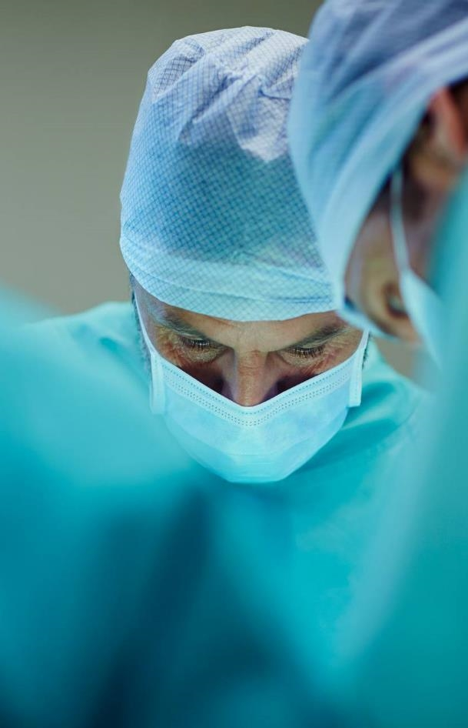
Introduction
Welcome to our innovative health prediction project, ["MediSmart Futures: Sharp Health Predictions"]. We're dedicated to leveraging advanced technology and data analytics to forecast heart, liver, and diabetes conditions. Our mission is to empower individuals/GP’s with early insights for them to guide the patients for a healthier tomorrow.
Our goal is to develop and implement predictive models that enable early detection and proactive management of heart, liver, and diabetes conditions. We aim to provide GP’s with knowledge they need to make informed decisions, ultimately improving patients’ overall well-being and quality of life
Questions:
How can we enhance the accuracy of disease prediction models?
What are the key markers for early detection of diseases?
What potential impact can early prediction and proactive management of these conditions have on public health and individual well-being?
How can predictive analytics assist healthcare professionals in making more informed decisions?
What impact can proactive health prediction have on public well-being?

Slide 3

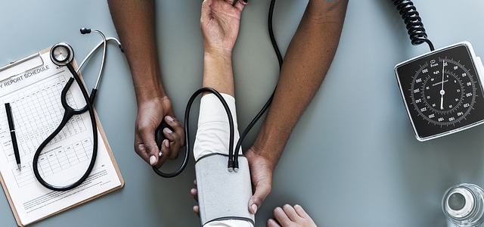
Scope
The project's scope is to provide a valuable tool for General Practitioners (GPs) in Australia. It involves developing a comprehensive healthcare prediction system that assists GPs in early detection and severity assessment of heart, liver, and diabetes conditions. The system offers to enhance GP’s to provide personalized health recommendations and facilitate referrals to specialists when required. The project aims to empower GPs with data-driven insights, aiding in more informed decision-making and enhancing patient care. By enabling GPs to detect symptoms early and offer proactive treatment, the project can improve patient outcomes and reduce healthcare costs, ultimately benefiting both GPs and their patients.

Slide 4

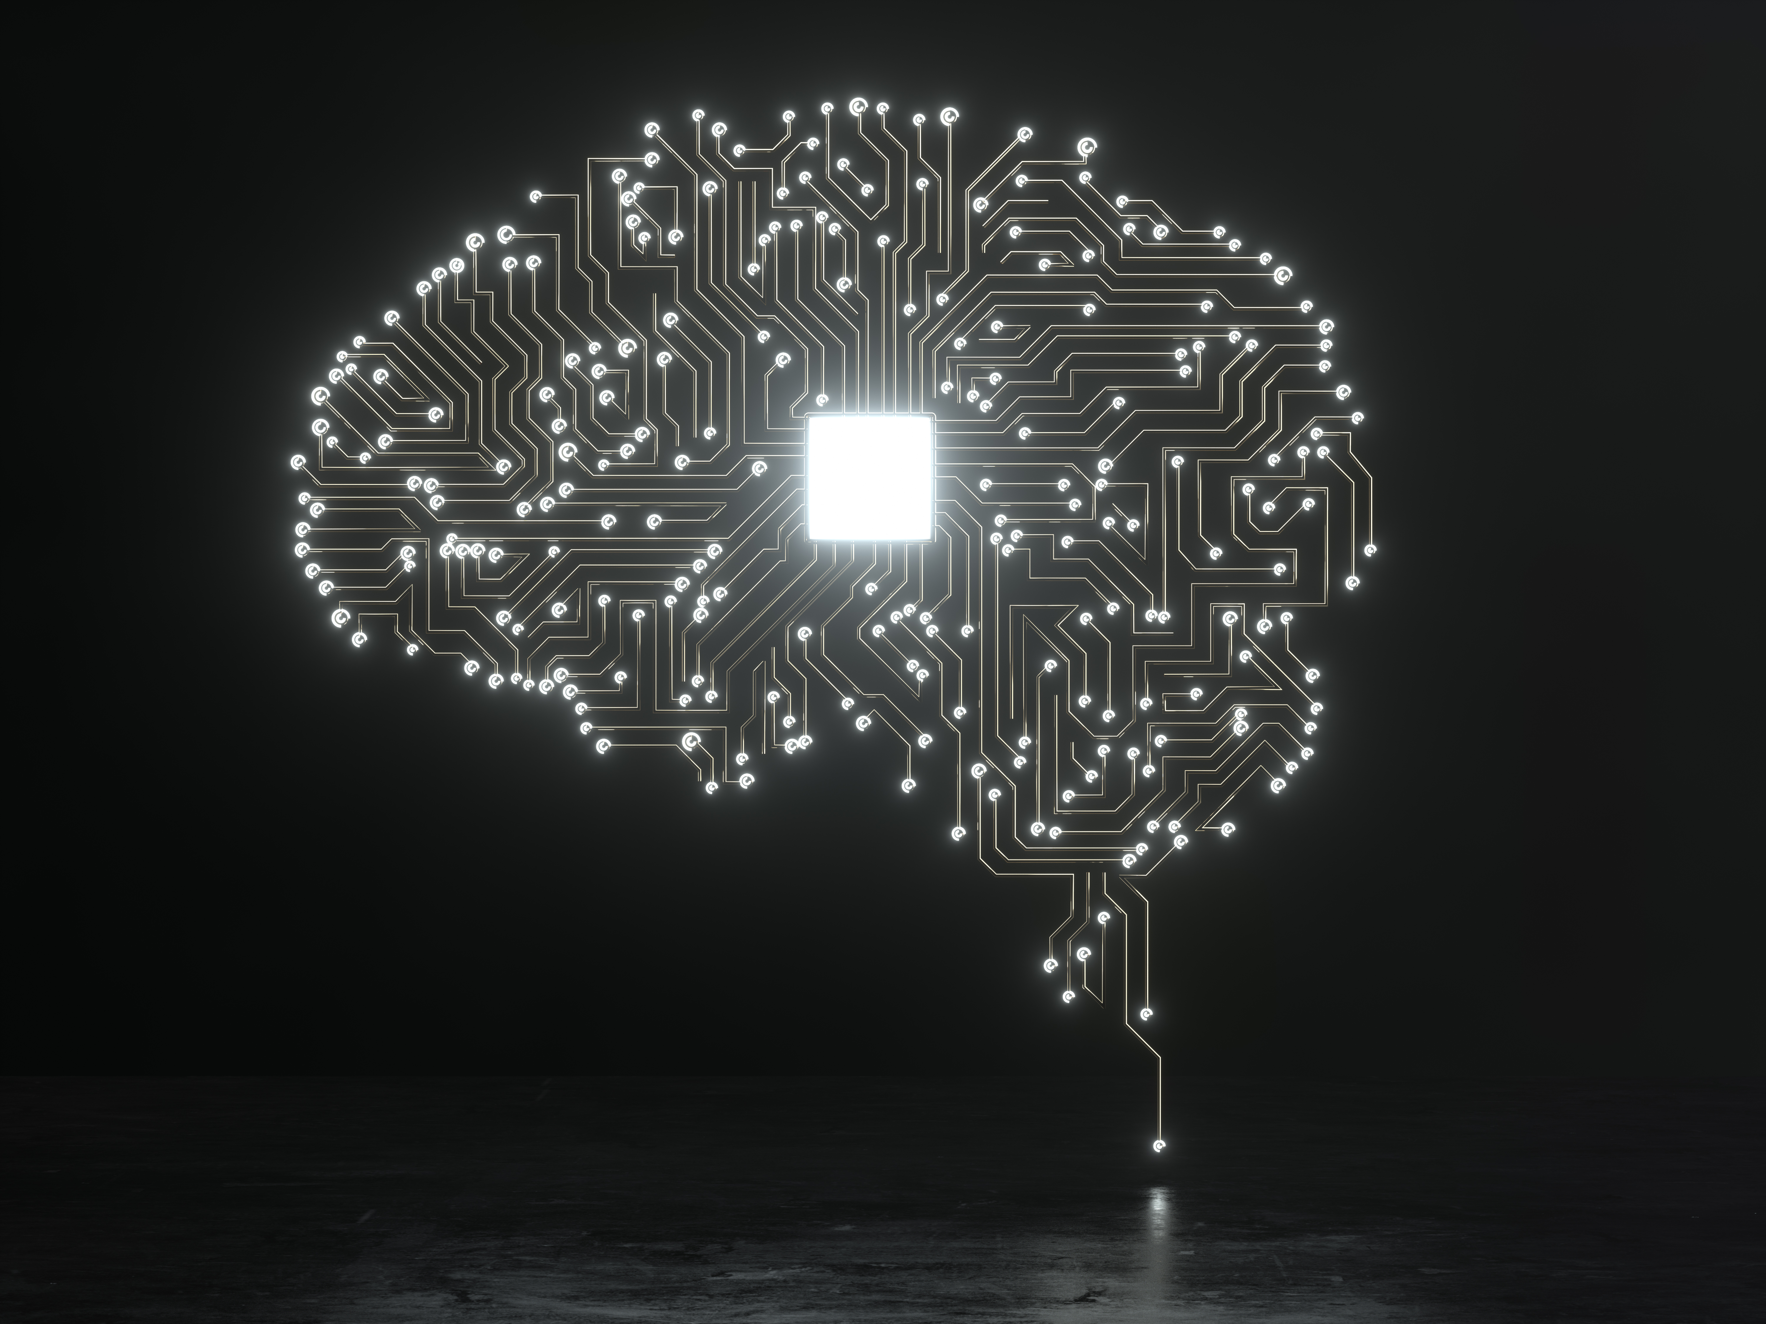

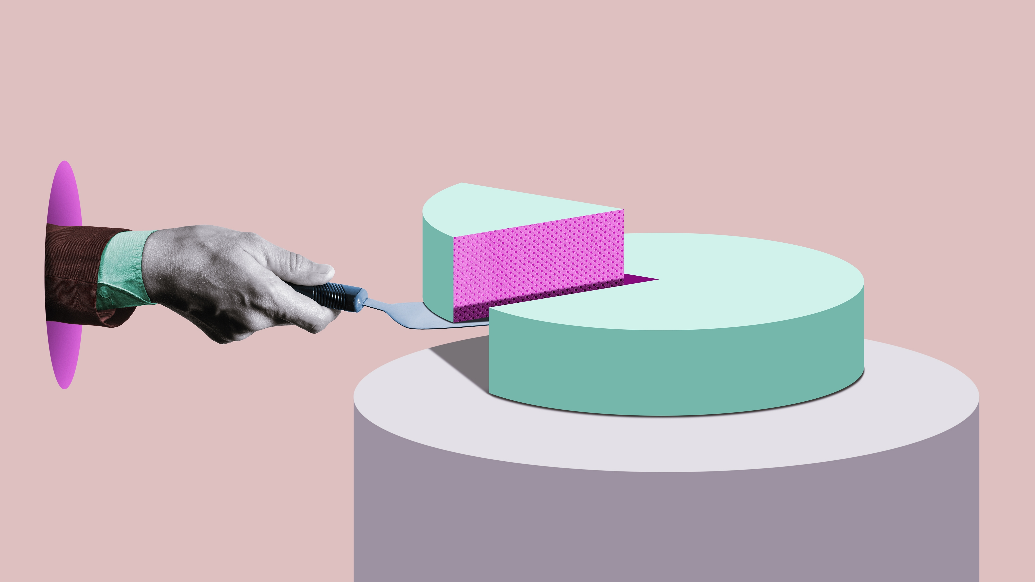
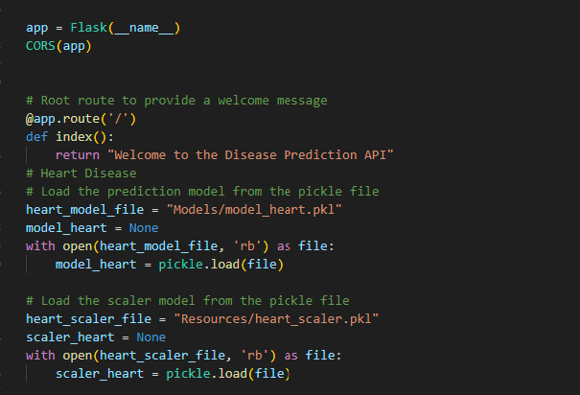
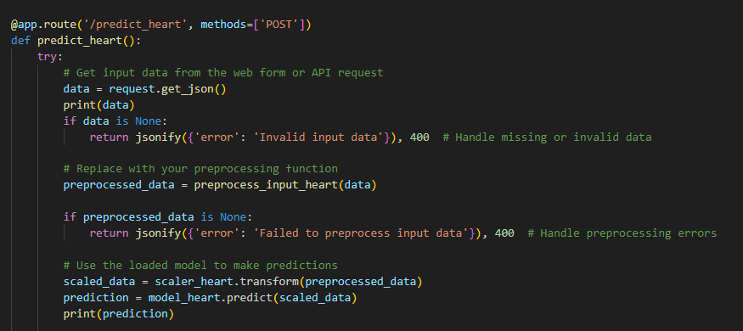
Breakdown of analysis
Data Cleaning
Model Creation
Creating Rules in Flask App
Predicting with HTML and JavaScript
Collected health data from various source, and medical databases.
Chosen suitable machine learning or statistical algorithms for heart, liver, and diabetes condition prediction.
Split the data into training and testing sets and train the models with the training data.
Evaluated model performance using metrics like accuracy, precision, recall, and F1-score.
Saved the trained models for future use.
Developed a Flask web application for the user interface.
Implemented backend logic in the Flask app, defining routes and views for data processing.
Created HTML forms for user data submission.
Used JavaScript to handle user input and interact with the Flask backend.
Ensured a seamless integration between the frontend and Flask backend for data transmission.
Displayed predictions and personalized health recommendations to users via the HTML interface.
Diabetes dataset link
https://www.kaggle.com/datasets/iammustafatz/diabetes-prediction-dataset
Heart dataset link
https://www.kaggle.com/datasets/fedesoriano/heart-failure-prediction
Liver data set link
https://www.kaggle.com/datasets/abhi8923shriv/liver-disease-patient-dataset

Slide 5
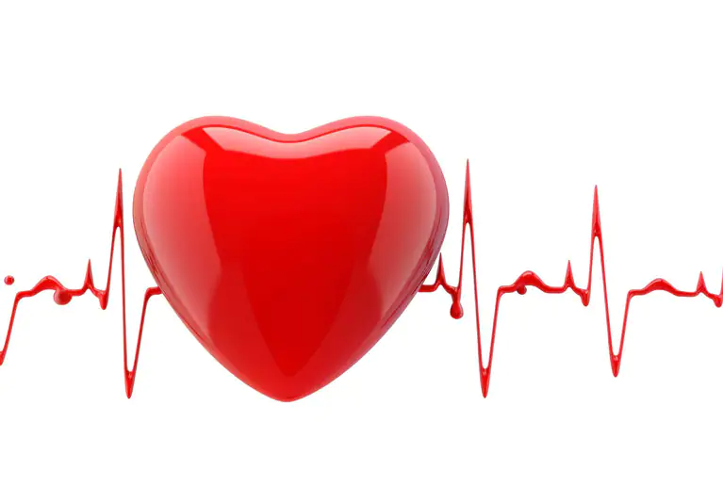
Heart:-"Prioritizing Heart Health: Your Path to Wellness"
"Our project is a comprehensive machine learning endeavor focused on predicting heart disease. We embark on this journey by meticulously preparing our data, uncovering insights through thoughtful exploration and compelling visualization. With the power of Keras, we craft a neural network model designed to unveil patterns in the data. Our dataset is cleaned, and categorical variables are artfully transformed. We divide our data into training and testing sets, ensuring a well-balanced model. As we scale the data, our neural network takes shape, learning from the training data. In the end, we evaluate our model using a confusion matrix, showcasing its predictive prowess. We also illuminate the path for future predictions, demonstrating the importance of data standardization and model scaling. The result? A powerful tool for heart disease prediction, ready to make an impact.“
Data Preprocessing and Exploration:
Data is loaded and explored.
Missing values are checked and summary statistics are calculated.
Correlation Analysis:
Correlations between features are visualized using a heatmap.
Data Visualization:
Scatter plots and pair plots are used to examine relationships between features and heart disease.
A box plot shows age distributions based on heart disease status.
Model Building and Training:
A neural network model is constructed and trained.
Model Evaluation and Deployment:
The model is evaluated with a confusion matrix.
The trained model and scaler are saved for future predictions.

Slide 6
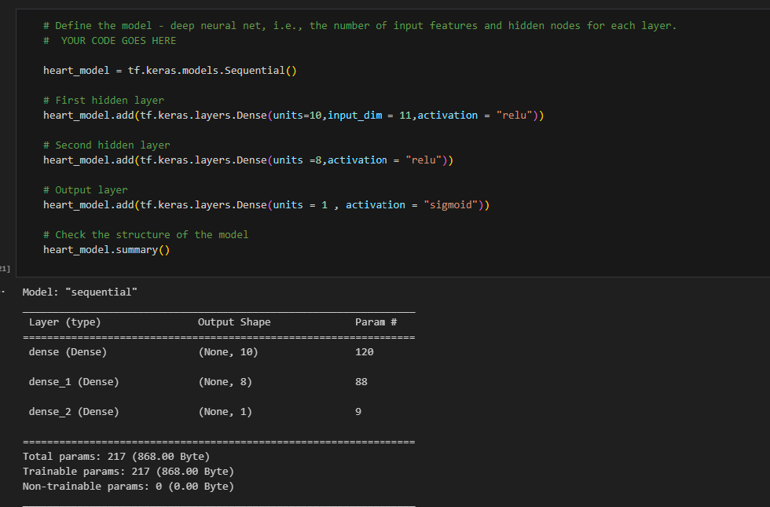
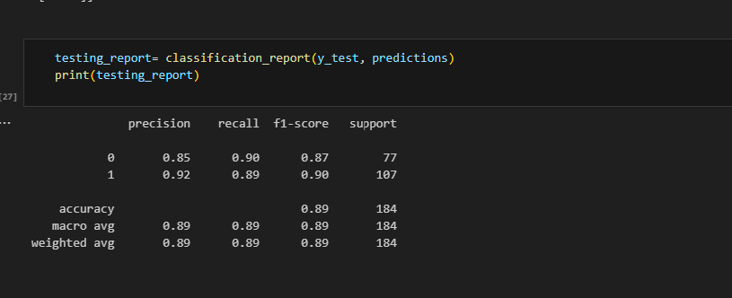
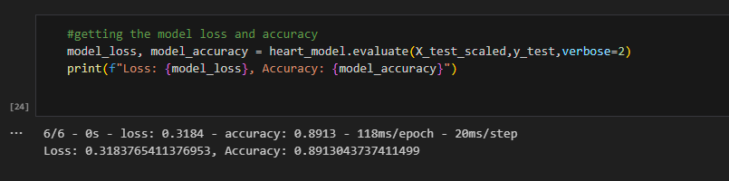
Heart Model Report
Heart model
Heart model classification report
Heart model Accuracy

Slide 7
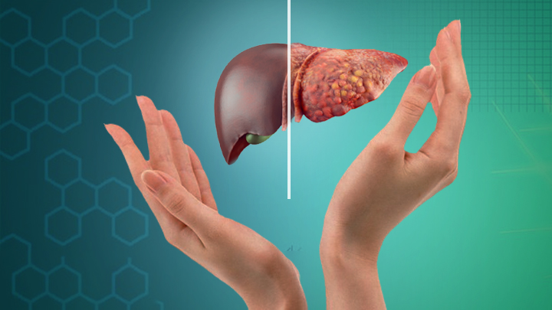
Liver:-"Understanding the Liver: Your Body's Vital Organ"
Liver disease prediction model using a liver dataset. It commences with meticulous data exploration, addressing missing values, and encoding categorical features for model readiness. Engaging visualizations offer insights into the data's intricacies. A correlation heatmap highlights relationships between age and bilirubin levels. The dataset is thoughtfully divided into training and testing sets, followed by feature scaling for consistent data treatment. A neural network model is crafted using TensorFlow's Keras API, featuring hidden layers with ReLU activation. Model performance is evaluated on the test set, emphasizing its predictive accuracy. This project underscores the significance of data preprocessing and neural network modeling for precise liver disease prediction.
Data Acquisition and Inspection:
The project initiates with data acquisition, loading data from a liver dataset.
It includes an initial inspection of data, checking for missing values, and tail data exploration.
Data Preprocessing and Encoding:
Missing data is addressed, and categorical variables like 'Gender of the patient' and 'Result' are one-hot encoded for model readiness.
Insightful Data Visualization:
Visualizations provide insights into data quality, featuring missing value visualizations and pie charts for gender distribution.
Histograms offer a deeper understanding of feature distributions concerning liver disease outcomes.
Correlation Analysis:
A correlation heatmap explores the relationship between age and total bilirubin levels, unveiling potential connections.
Model Development and Evaluation:
A neural network model is created using TensorFlow's Keras API with hidden layers featuring ReLU activation functions.
The model is compiled and evaluated for its predictive accuracy on the test dataset.

Slide 8
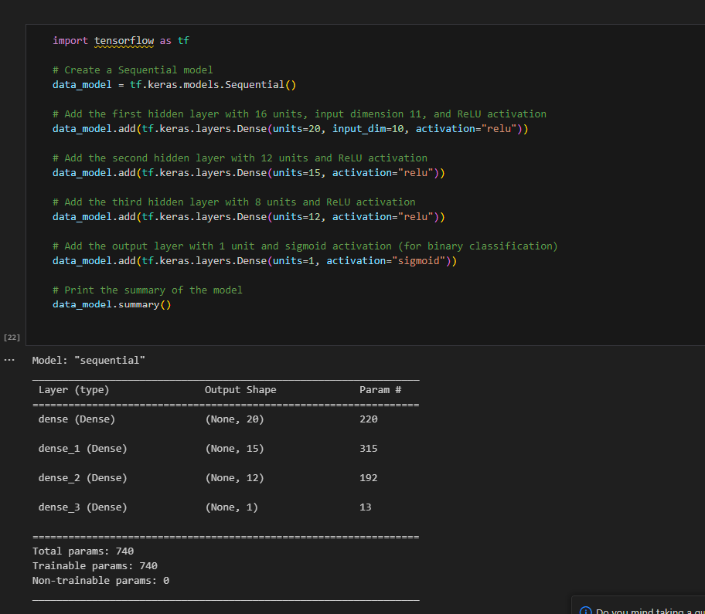
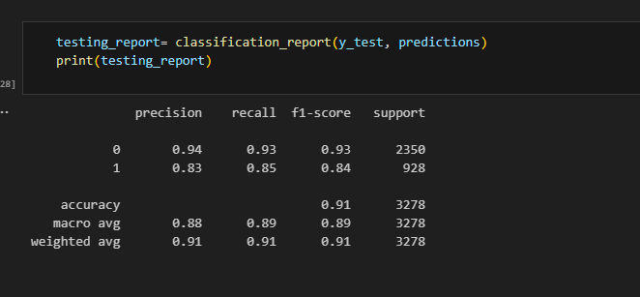
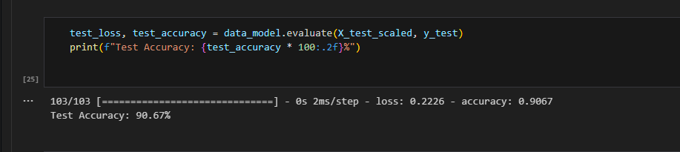
Liver model report
Liver model
Liver model classification report
Liver model Accuracy

Slide 9
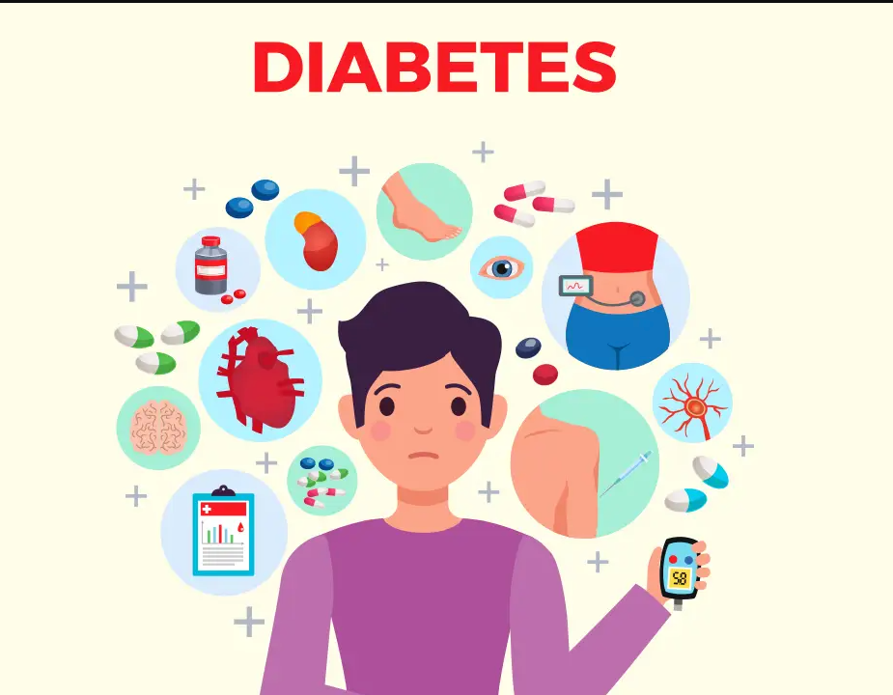
Diabetes :- "Diabetes Prevention: Steps to a Healthier Future"
In our project, we embark on an in-depth analysis of a diabetes prediction dataset. Our journey begins with data ingestion and visual exploration to unveil intricate feature correlations. We then focus on feature scaling for consistent data treatment. The heart of our analysis lies in the creation of a logistic regression model, rigorously evaluated to assess its predictive accuracy. Notably, we address class imbalance concerns through expertly applied random oversampling, enhancing model performance.
Data Exploration and Visualization:
This stage involves loading the diabetes prediction dataset and visually exploring its characteristics, including correlations between features.
Feature Scaling and Data Preparation:
Feature scaling is applied to ensure uniform data treatment, enhancing model performance. The dataset is carefully prepared for modeling.
Model Construction and Evaluation:
A logistic regression model is meticulously crafted, followed by rigorous evaluation to assess its predictive accuracy.
Addressing Class Imbalance:
Recognizing the presence of class imbalance in the dataset, this phase employs random oversampling to rectify the issue, ultimately improving model reliability.
Resampling and Performance Assessment:
After resampling, data is re-scaled for integrity. The model is then re-evaluated, with its performance post-resampling meticulously assessed.

Slide 10
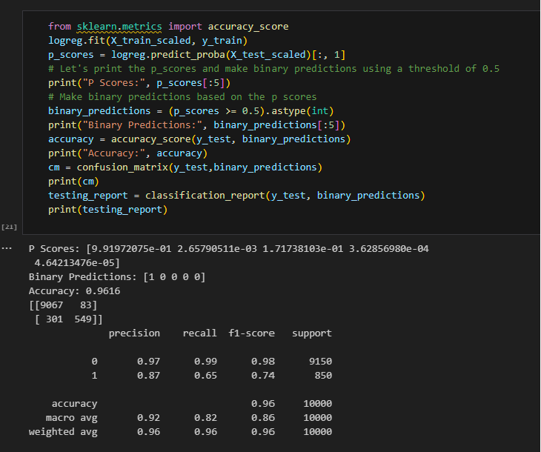
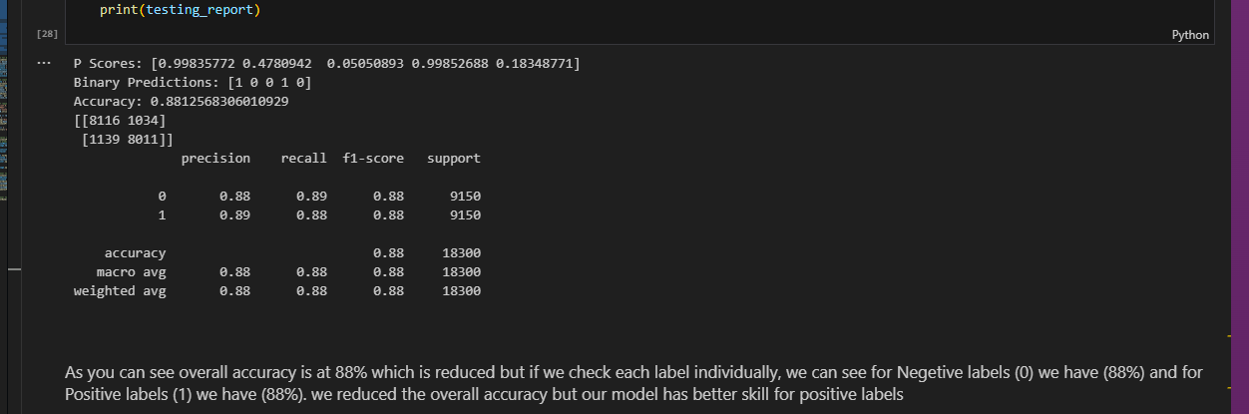
Diabetes model classification report
As you can see overall accuracy is at 96% which is okay but if we check each label individually, we can see for Negative labels (0) we have very high f1-score (98%) but for Positive labels (1) we have very low f1-score (74%).
The algorithm predicted poorly in Positive labels and we predicted 36% of diabetic persons have no diabetes. This high amount of error can be dangerous if we use our model for diabetes prediction.
So label imbalance can heavily affect the result of our machine learning algorithms.
This imbalance leads to algorithms with High Accuracy but No Skills
Random Over Sampler
This method generates new samples by randomly sampling with replacement the current available samples. This method randomly duplicate examples in the minority class.
As you can see overall accuracy is at 88% which is reduced but if we check each label individually, we can see for Negative labels (0) we have (88%) and for Positive labels (1) we have (88%). we reduced the overall accuracy, but our model has better skill for positive labels

Slide 11
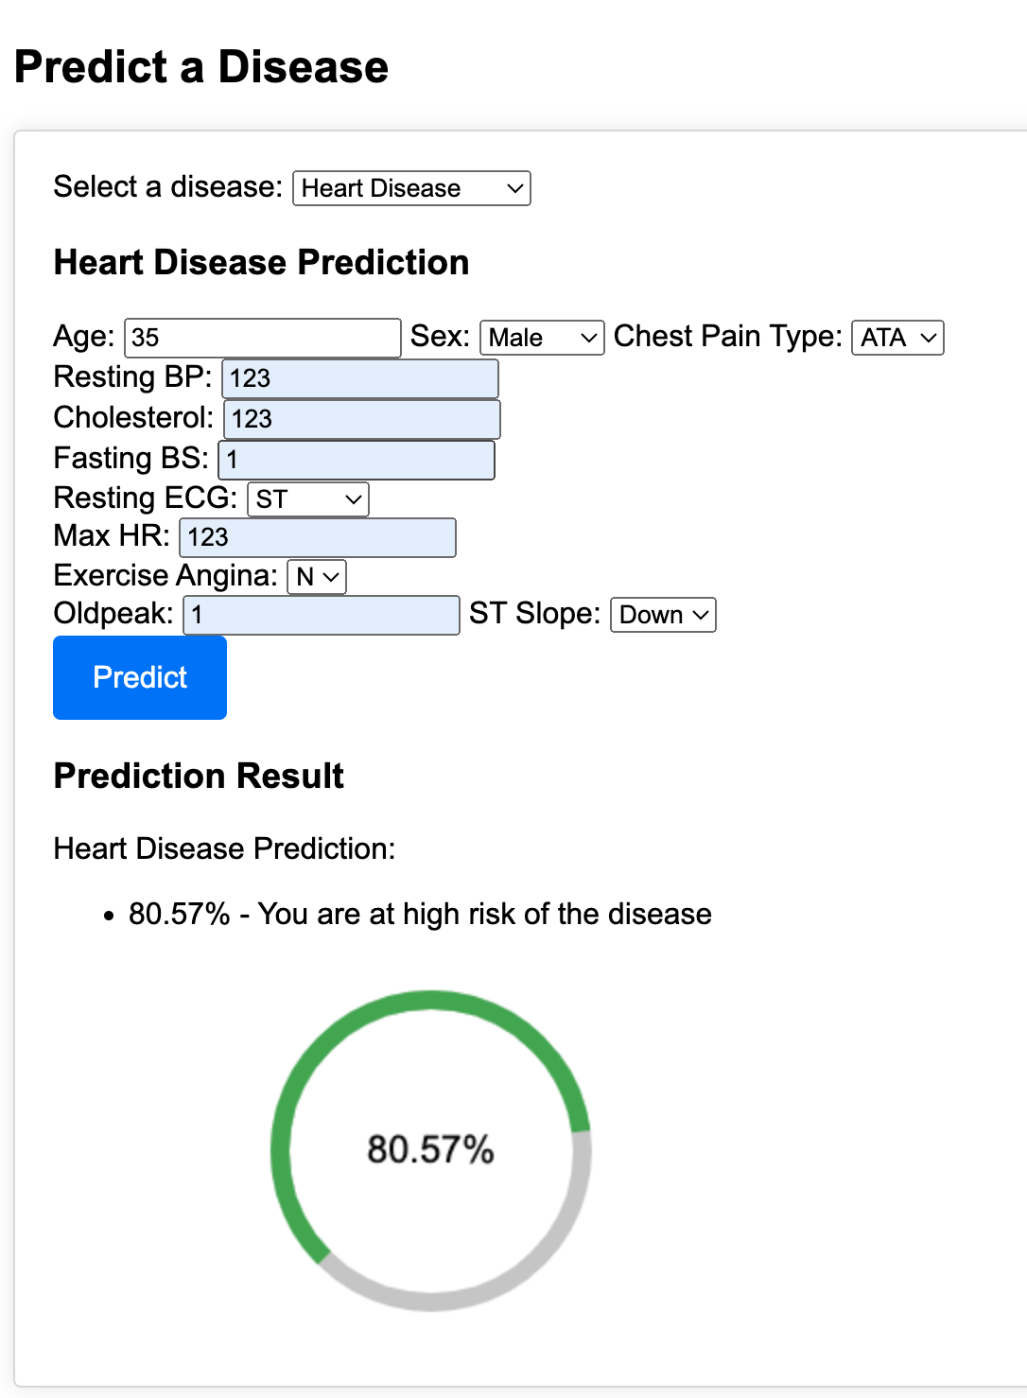
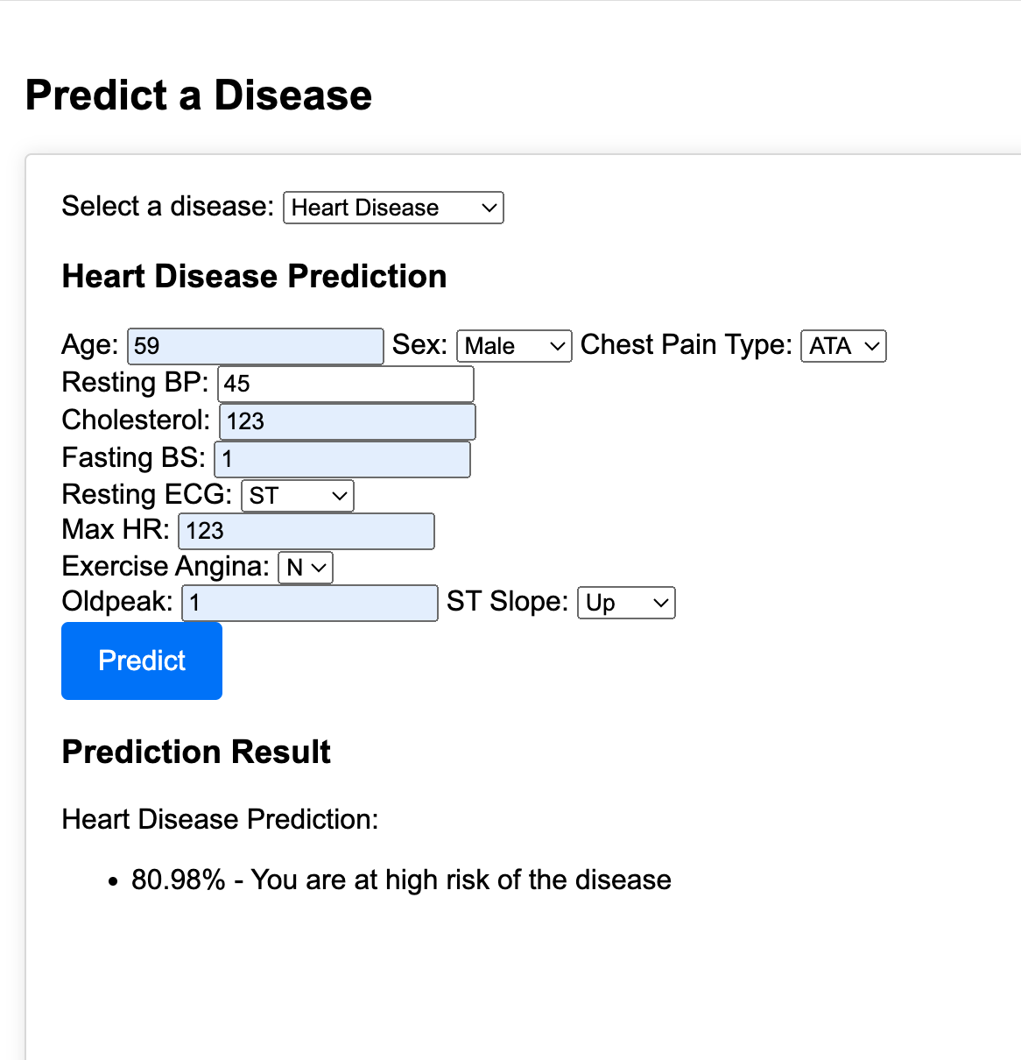
Visualisation of MediSmart Futures
We created a visualization which will give us dropdown box where we can input the patient details so that our model will give us predictions about the diseases which helps the patients to take further precautions about their health.
The higher the accuracy more accurate is their predictions.
It will help the GP’s to check the severity of the disease so they can recommend the patients to specialist doctors accordingly.

Slide 12
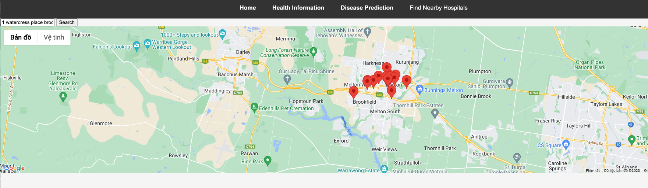
Map to check nearby hospitals:-
For the frontend we used React, HTML, CSS, and JavaScript. In the backend, we used Node.js and Express.js for the server and Heroku for deployment. The Google Maps Places and Google Maps Nearby APIs were used to locate users and find hospitals nearest to them.
We'd like to add more robust google map features as well as a way for hospitals/testing sites to indicate they have a high volume of patients and are to be avoided. We would also like to explore the possibility of a database and populated map with the general locations of people who reported serious symptoms, so that hospitals can monitor possible outbreaks.
CSS
express.js
google
google-latitude
google-maps
html
node.js
react

Slide 13
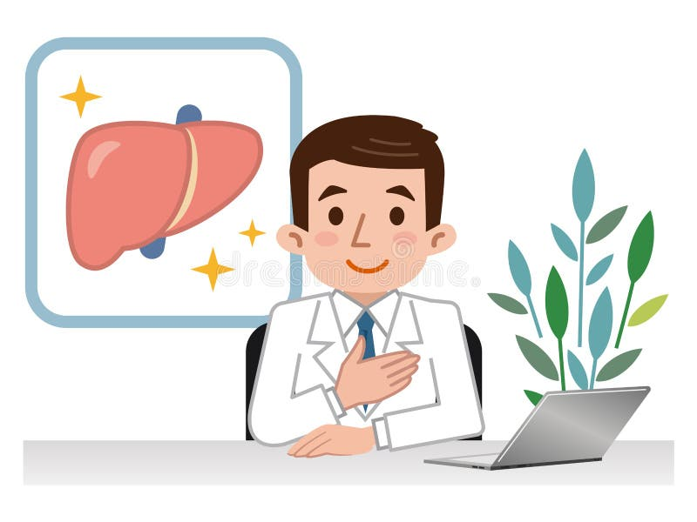

Conclusion: In conclusion , we have successfully fulfilled the project's initial objectives, which included developing predictive models and designing a user-friendly front-end interface for general physicians to assess disease probabilities in patients. Nevertheless, given the project's medical nature, the utmost importance lies in achieving a high degree of accuracy and precision in disease prediction. To this end, we propose the following strategic actions to further enhance the model predictions. Methods to enhance accuracy: Balancing Data: To achieve better predictions, we need to have a fair amount of data for each type of health condition we're predicting. If one condition has too much data and another has too little, our predictions can become biased. We want to make sure we have a balanced dataset, where each condition is represented equally. Collecting More Data: Sometimes, we might not have enough data for certain health conditions, making predictions challenging. To address this, we'll gather more information for these underrepresented cases. This will help our models become more accurate. Data Augmentation: Data augmentation is like creating variations of the information we already have. It adds diversity to our dataset, which can improve the performance of our models. Handling Missing Data: In some cases, we might have missing or incomplete information. We can deal with this by making educated guesses (imputation) or carefully removing the incomplete data. This ensures the quality of our data. Resampling: Resampling techniques like oversampling (creating more instances of the minority class) or under sampling (reducing the majority class) help us balance the representation of different conditions in our dataset. Model Fine-Tuning: Just like a musical instrument, our models have settings that can be adjusted for better performance. We'll fine-tune these settings to make sure our models work as accurately as possible. Ensemble Methods: Ensemble techniques combine multiple models to make predictions. They can increase accuracy and reliability. Cross-Validation: Cross-validation is a method to ensure that our models are not just good at predicting the data they were trained on but are also capable of making accurate predictions on new, unseen data.

Slide 14

We hope to expand our application to more people in the future and look for ways to increase our app scalability. It would be awesome to see this app developed on a native platform in the future! Thank you
"Health is wealth, and technology is its guardian.“

